Slide 1


EDA of airbnb
Tushar muley
Dsc 530
Bellevue university
Professor: Matthew Metzger

Slide 2


Abstract
Airbnb is a vacation rental online marketplace company headquartered in San Francisco, California. The company itself does not own any of the rental properties that are posted on its site. It is a marketplace that allows hosts and renters to find each other. The company started in August of 2008 as Air Bed & Breakfast and has gone through a couple of iterations until arriving at is current version known simply as Airbnb.
In recent years Airbnb has come under scrutiny because it takes away potential renters from hotels and other service providers that are under different regulation and provide tax revenue to municipalities.
My analysis takes a look at different variables that are available from Inside Airbnb site which is not associated with Airbnb. Some of the basic questions I wanted to look at concern what variable play a part in profitability for hosts.

Slide 3
The Data
The data was screen scraped by a site called Inside Airbnb from Airbnb’s publicly available data.
The data elements I used are listed on the next slide. It contains about 31,536 rows of data after removing nulls. This is limited to the Los Angeles area and probably just Orange County.

Slide 4
Data Selection
Data obtained from independent website called Inside Airbnb
Price (price_am)– Available or booked nightly rate in the native currency chosen by the host
Accommodates (accommodates)–The maximum number of guests the vacation rental property can accommodate
Host Listing Count (host_listing_count) – Number of listing on Airbnb by the same host id
Availability (availability_30) – The number of available nights in a 30 day period
Number Reviews LTM (number_of_reviews_ltm) – Number review left for hosts in the last twelve months (LTM)
Super Host (host_is_superhost) – True or False depending if the host is a Superhost on Airbnb
Neighborhood (neighbourhood_cleansed) – Name if city where the host rental is located. Airbnb has structured this field so all the free form text is accurate. Removes sub-neighborhoods.
Review score rating (review_scores_rating) – Rating of all the scores based on the review.
Review scores values (review_scores_values) – Value of the scores on the review.
Property Type (property_type) Type of property being rented i.e. apartment, room, guest house

Slide 5
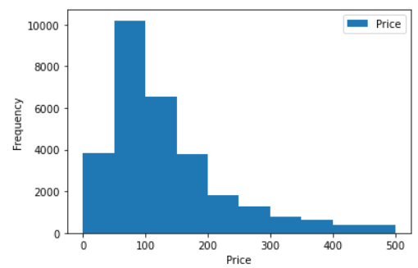
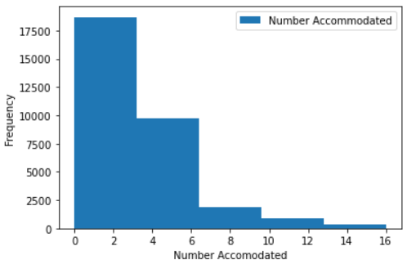
Histogram of the Variables
Price
Mean: 222.6823
Variance: 368210.0867
Standard Deviation: 606.8031
Mode: 0 100.0
Price or Price_am the range is higher than $500, but I limited histogram since frequency after $500 dropped and number of host was less. Skewing was cause by the higher amounts.
The data is left skewed with trail towards the right mean this is positive skewed. The mean is $222 with mode being $100. The standard deviation is fairly distance from the mean of $222 dollars compared to $606.
Number Accommodations
Mean: 3.5598
Variance: 6.5136
Standard Deviation: 2.5521
Mode: 0 2
Number of accommodations – This field provide number of people that can occupy a rental. The histogram is positively skewed and trails off quickly after 6. Majority of rentals are between 1 and 3.55 around that to 4. The standard deviation is close to the mean which is good. It means rentals are occupying similar space and complete against each other for renters.

Slide 6
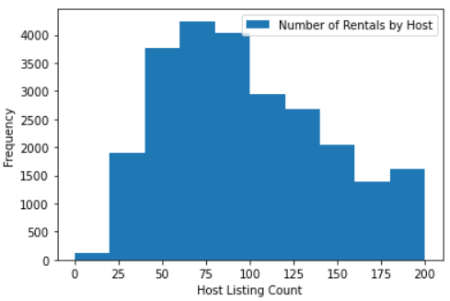
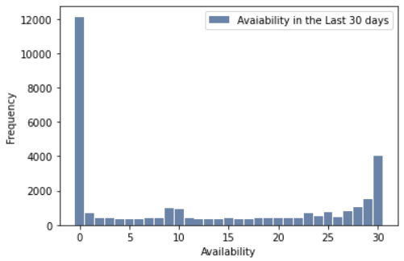
Histogram of the Variables
Number of Listing By Host Mean: 31.9552
Variance: 27332.0754
Standard Deviation: 165.3241 Mode: 0 1.0
Median: 2.0
Number of Listing by Host – Based on the mean of 31.9552. It seems Hosts have more than one place listed on Airbnb. Possible running a hosting business?
The histogram indicated distribution in the tails leading to negative kurtoise. The mode indicate a 1. The median shows to be 2.0 which would mean majority of the Host are only listed twice and maybe just using their second home or apartment as a rental to bring in additional income.
Availability
Mean: 12.0282
Variance:148.1866
Standard Deviation: 12.1731
Mode: 0 0
Availability in the last 30 days has some pretty good stats. Zero availability is the highest followed by 30. The average is 12 and mode shows common number as 0.
Additional analysis could be done around availability according to location see if that show relationship.

Slide 7
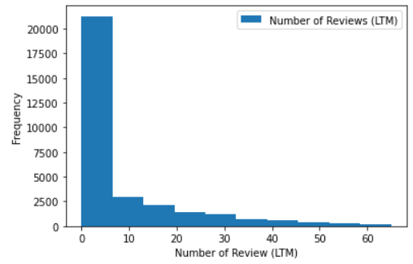
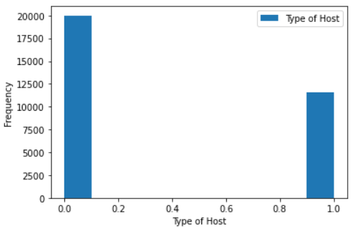
Histogram of the Variables
Number of Reviews (LTM) Mean: 8.8387
Variance: 239.5647 Standard Deviation: 15.4778 Mode: 0 0
Median> 2.0
The number of review left by renter for host average is 9. Which I am not sure if this good or bad. The histogram is positively skewed. The median is 2 indicating that is most number appearing. The standard deviation is 15.4778 which close to double the mean. Additional review and cleansing of data might be needed.
Super host
Mean: 0.3655
Variance: 0.2319
Standard Deviation: 0.4815 Mode: 0 0.0
This was expected as the values are True (T) or False (F). What this indicates is being a Super Host in the eyes renters does not have an impact. As you have more non Super Hosts (Regular Hosts). There is a criteria Airbnb requires to maintain a Super Host status. Including high response rate, lower cancelation requirements. But this do not appear to contribute to an additional financial gain as the analysis will show.

Slide 8
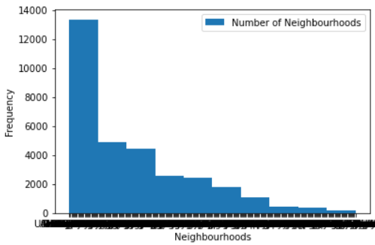
Histogram of the Variables
The number of neighborhoods or location is pretty interesting. A major categorical variable.

Slide 9
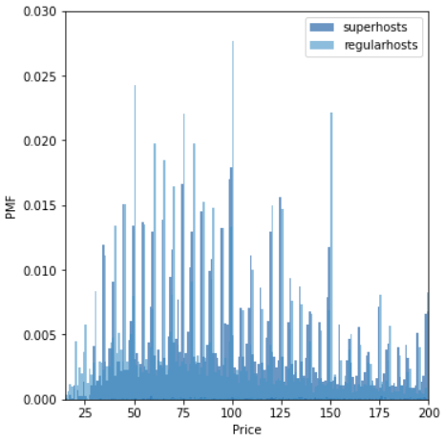
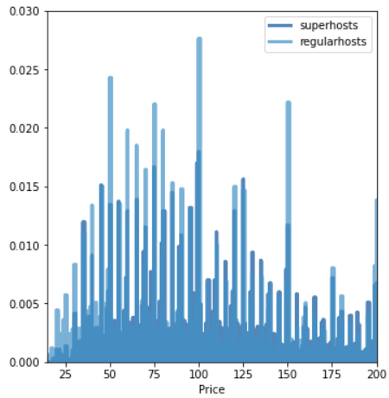
Comparing Two Variables Different Scenario
Comparing two types of host to prices they charge. There was no evidence that says being a Super Host provided any additional benefits to pricing.
In the Jupyter Notebook for this analysis I did a similar comparison to Number of Review in the last twelve months and saw similar results. Being a Super Host did not provide any benefits.
In most cases a regular host priced their rentals similar or higher to Super Hosts.
From a pricing of rental and reviews left there is no impact of being a Super Host vs. a Regular Host.

Slide 10
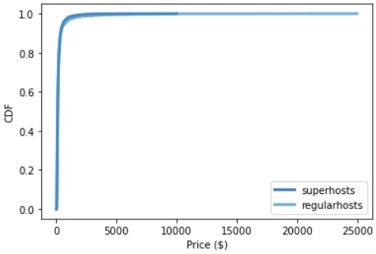
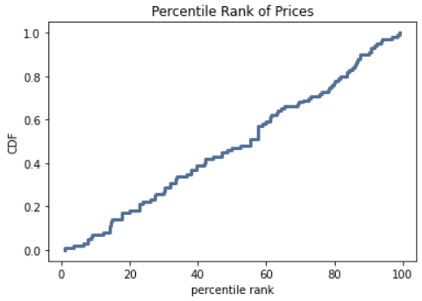
CDF of Price Variable
Comparing the CDFs of Super Host and Regular Host. Both CDFs are similar with Regular Host have a very slight difference. Not much between the two type of hosts when is comes to price.
The only difference would be the range that Regular Host have compared to Super Hosts.
If you look at the graph of Number of Review for Super Host and Regular Host. Note that Super Host graph has a little more arc. You have more review that are not zero compared to Regular Hosts.
I performed a sample random percentile Rank of Prices. Note the line is nearly straight with a slight dip between 55% and 59%. This is pretty uniformed.

Slide 11
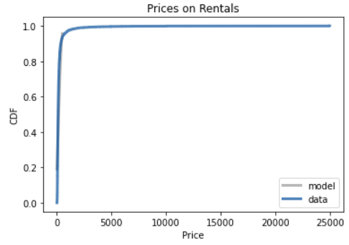
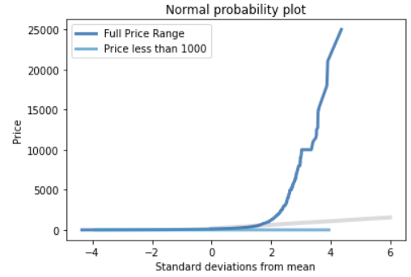
Analytical Distribution
The Analytical Distribution due to the amount of values between 0 and 1 for CDF are large causing the graph to climb to 1 quickly and level across until ending at $24,999. The model would mirror this as well.
I limited the dollar amount to $1,000 and under. I did this because the mean was $222 and the mode was $100. Based on that I replotted the graph using standard deviation from the mean.
In the Normal Probability Plot (bottom graph) please note once higher dollar amounts are removed the model and price are very close together. If you add in the Full Price Range ($0 – $24,999) you get a curve from 2 going nearly straight up similar to the Prices on Rentals plot.

Slide 12
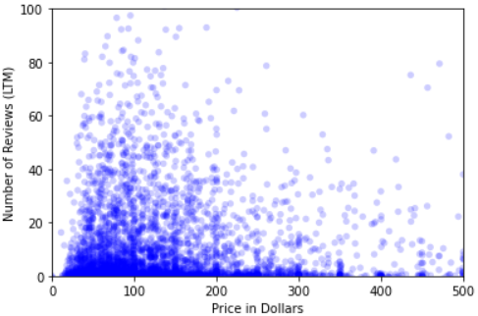
Scatter Plot Comparing Price and Reviews
Correlation: -0.0605
Covariance: -568.3257
Spearman Correlation: -0.01901
Since Price and Host Type did not produce a very good scatter plot (In my Jupyter Notebook). I did a scatter plot of Number of Reviews to Price of rentals.
After jittering the data and putting in ranges for the price to make getting the max number of review in the thick of the rental price. You can see the correlation is negative -0.0605. The Spearman correlation was also negative at -0.01901. That number of reviews do not effect price of the rental.
This just shows more reviews are left at the lower price range. We could make assumptions about that but without overall ratings we would not know the effect of reviews having on price.

Slide 13
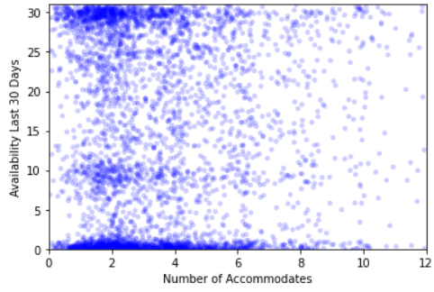
Scatter Plot Comparing Accommodation and Availability
In this scatter plot with accommodation and availability to understand what is more in demand. Large groups of 6 or more or smaller groups of 5 and less. There is a positive correlation of 0.03854 between accommodations and availability.
The availability is split between none and 30 days. I would have to imagine that location would play a part in analysis. Assuming popular locations have zero availability compared to less popular locations.
Correlation: 0.03854
Covariance: 1.1975
Spearman Correlation: 0.0021

Slide 14
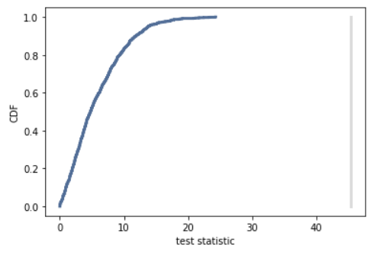
Hypothesis Testing Host Type and Price
The hypothesis test came back with a p-value of 0.0 meaning there is no effect on price based on if the host is a super host or a regular host.
I looked into other test as well. The Correlation Test came back as 0.0 as the p-value.
I believe from the test I ran I can conclude there is no relationship between host type and price charged.
From the evidence we have seen so far all the test support that there is no relation between price and host type.

Slide 15
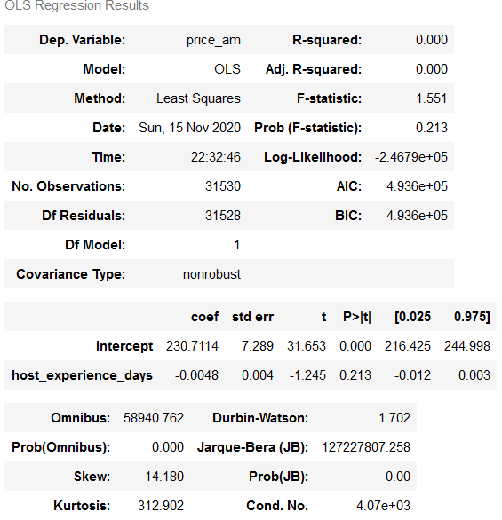
Regression Analysis
The Regression Analysis was completed on price and host experience days which was an element I had to create based off host since date and last scrape date. This allowed me to determine how much experience a host has being on Airbnb.
The Prob(F-statistic): 0.213 relation is not significant.
Also adding that r² is 0.000.
I checked a few other variables as well. That data can be found in my Jupyter Notebook.
Location did not have a relationship to price either.
The one relationship while very small between price dependent on host type and number reviews.
The 1.07e-34 p-value and r² 0.005. Nothing significant.

Slide 16








Conclusion
Airbnb Host do make money. It probably depends are a variety of variables. The most significant being cost. We do not know the Host cost. I am not sure of the amount since it is difficult to calculate occupancy due to the data.
Based on the data I do believe there are Host that run a business on Airbnb. These are not just local B and B but other rentals like apartments and possible smaller hotels.
Based on the analysis host experience does not have an impact on price. With the p-value of 0.231 it is not significant.
I looked at other variable like location, accommodation there is not enough data to determine how much impact those variable have on Price.
GitHub URL:https://github.com/chemistrusaz/GitHub/tree/master/DSC530_MMetzger_Fall2020/Week_12_Final_Project

